Slide 1
Lecture 2: Introduction to Unix and its Commands

Slide 2
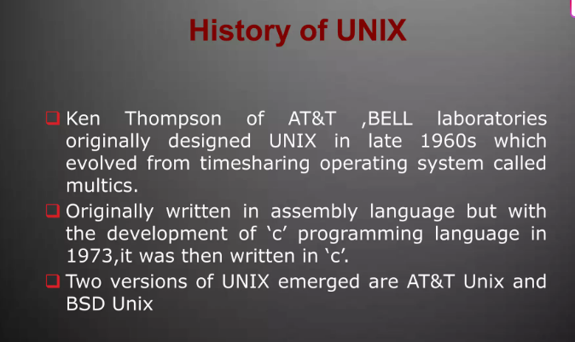
Notes:
When the web was conceived, browsers were limited to text and image - later tables and frames. The extent to which they provided interactivity with the user was very limited. JavaScript was developed by Netscape as a simple programming language (often referred to as a scripting language). It is easy to learn and small sections of JavaScript can be added to a web page rather than needing to develop complicated programs. It was specially designed for web page interaction and manipulating the web browser and page elements. It is often used to respond to user actions such as mouse clicks.
Although developed by Netscape, and other variants exist, such as Jscript from Microsoft, a standard has been developed by the European Computer Manufacturers Association. It is known as ECMAScript, using the standard ECMA262, which can be found fully documented at the address on the slide.

Slide 3
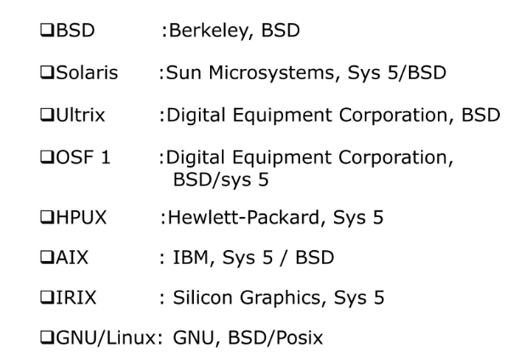
Notes:
When the web was conceived, browsers were limited to text and image - later tables and frames. The extent to which they provided interactivity with the user was very limited. JavaScript was developed by Netscape as a simple programming language (often referred to as a scripting language). It is easy to learn and small sections of JavaScript can be added to a web page rather than needing to develop complicated programs. It was specially designed for web page interaction and manipulating the web browser and page elements. It is often used to respond to user actions such as mouse clicks.
Although developed by Netscape, and other variants exist, such as Jscript from Microsoft, a standard has been developed by the European Computer Manufacturers Association. It is known as ECMAScript, using the standard ECMA262, which can be found fully documented at the address on the slide.

Slide 4
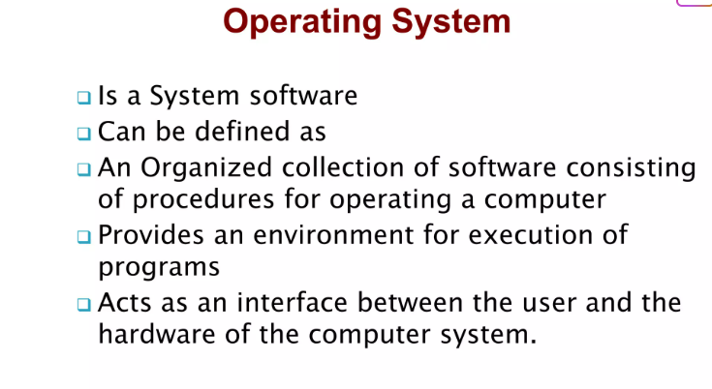
Notes:
When the web was conceived, browsers were limited to text and image - later tables and frames. The extent to which they provided interactivity with the user was very limited. JavaScript was developed by Netscape as a simple programming language (often referred to as a scripting language). It is easy to learn and small sections of JavaScript can be added to a web page rather than needing to develop complicated programs. It was specially designed for web page interaction and manipulating the web browser and page elements. It is often used to respond to user actions such as mouse clicks.
Although developed by Netscape, and other variants exist, such as Jscript from Microsoft, a standard has been developed by the European Computer Manufacturers Association. It is known as ECMAScript, using the standard ECMA262, which can be found fully documented at the address on the slide.

Slide 5
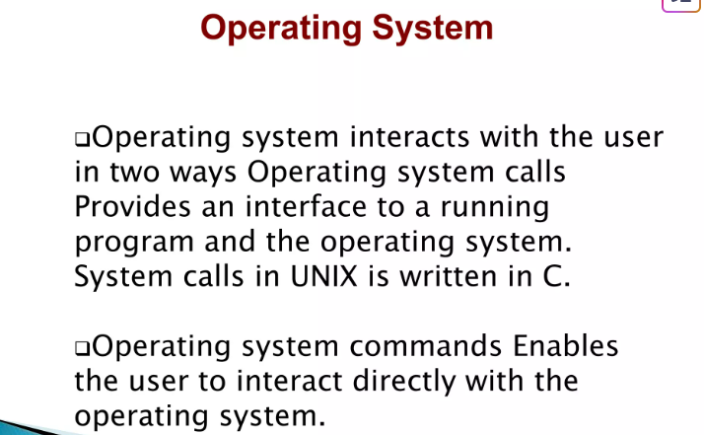
Notes:
When the web was conceived, browsers were limited to text and image - later tables and frames. The extent to which they provided interactivity with the user was very limited. JavaScript was developed by Netscape as a simple programming language (often referred to as a scripting language). It is easy to learn and small sections of JavaScript can be added to a web page rather than needing to develop complicated programs. It was specially designed for web page interaction and manipulating the web browser and page elements. It is often used to respond to user actions such as mouse clicks.
Although developed by Netscape, and other variants exist, such as Jscript from Microsoft, a standard has been developed by the European Computer Manufacturers Association. It is known as ECMAScript, using the standard ECMA262, which can be found fully documented at the address on the slide.

Slide 6
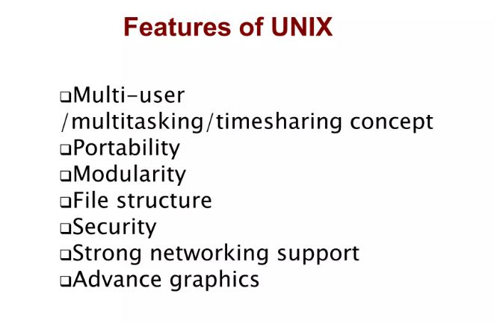
Notes:
When the web was conceived, browsers were limited to text and image - later tables and frames. The extent to which they provided interactivity with the user was very limited. JavaScript was developed by Netscape as a simple programming language (often referred to as a scripting language). It is easy to learn and small sections of JavaScript can be added to a web page rather than needing to develop complicated programs. It was specially designed for web page interaction and manipulating the web browser and page elements. It is often used to respond to user actions such as mouse clicks.
Although developed by Netscape, and other variants exist, such as Jscript from Microsoft, a standard has been developed by the European Computer Manufacturers Association. It is known as ECMAScript, using the standard ECMA262, which can be found fully documented at the address on the slide.

Slide 7
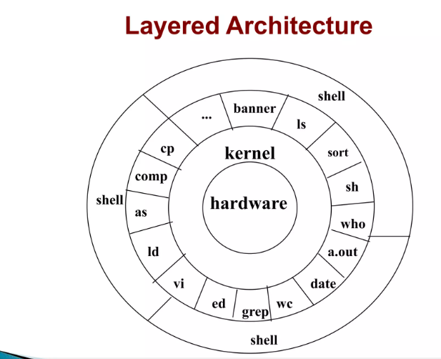
Notes:
When the web was conceived, browsers were limited to text and image - later tables and frames. The extent to which they provided interactivity with the user was very limited. JavaScript was developed by Netscape as a simple programming language (often referred to as a scripting language). It is easy to learn and small sections of JavaScript can be added to a web page rather than needing to develop complicated programs. It was specially designed for web page interaction and manipulating the web browser and page elements. It is often used to respond to user actions such as mouse clicks.
Although developed by Netscape, and other variants exist, such as Jscript from Microsoft, a standard has been developed by the European Computer Manufacturers Association. It is known as ECMAScript, using the standard ECMA262, which can be found fully documented at the address on the slide.

Slide 8
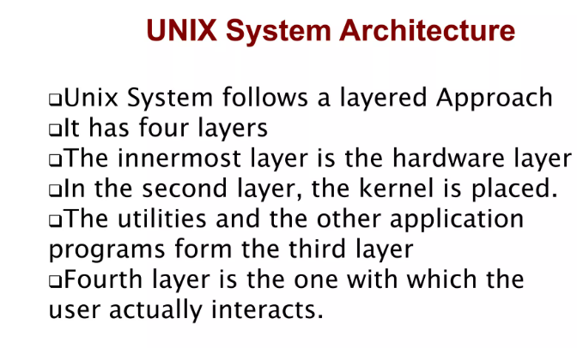
Notes:
When the web was conceived, browsers were limited to text and image - later tables and frames. The extent to which they provided interactivity with the user was very limited. JavaScript was developed by Netscape as a simple programming language (often referred to as a scripting language). It is easy to learn and small sections of JavaScript can be added to a web page rather than needing to develop complicated programs. It was specially designed for web page interaction and manipulating the web browser and page elements. It is often used to respond to user actions such as mouse clicks.
Although developed by Netscape, and other variants exist, such as Jscript from Microsoft, a standard has been developed by the European Computer Manufacturers Association. It is known as ECMAScript, using the standard ECMA262, which can be found fully documented at the address on the slide.

Slide 9
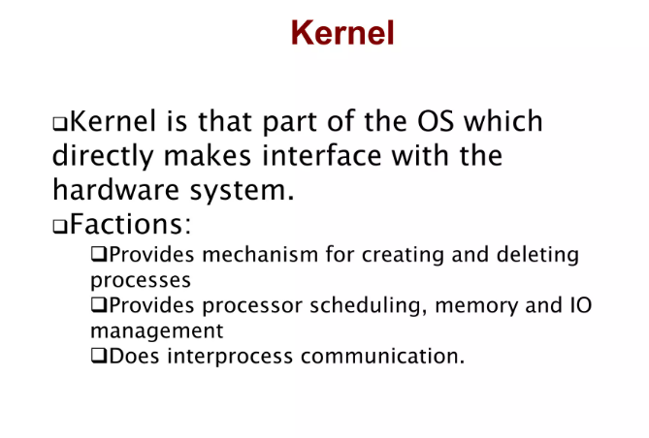
Notes:
When the web was conceived, browsers were limited to text and image - later tables and frames. The extent to which they provided interactivity with the user was very limited. JavaScript was developed by Netscape as a simple programming language (often referred to as a scripting language). It is easy to learn and small sections of JavaScript can be added to a web page rather than needing to develop complicated programs. It was specially designed for web page interaction and manipulating the web browser and page elements. It is often used to respond to user actions such as mouse clicks.
Although developed by Netscape, and other variants exist, such as Jscript from Microsoft, a standard has been developed by the European Computer Manufacturers Association. It is known as ECMAScript, using the standard ECMA262, which can be found fully documented at the address on the slide.

Slide 10
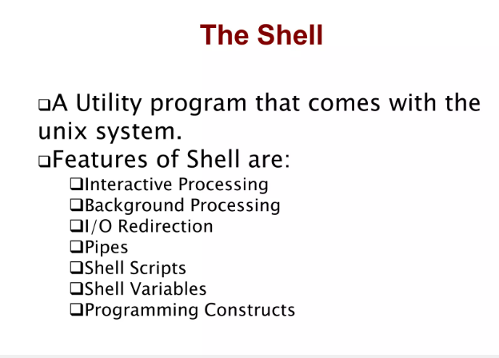
Notes:
When the web was conceived, browsers were limited to text and image - later tables and frames. The extent to which they provided interactivity with the user was very limited. JavaScript was developed by Netscape as a simple programming language (often referred to as a scripting language). It is easy to learn and small sections of JavaScript can be added to a web page rather than needing to develop complicated programs. It was specially designed for web page interaction and manipulating the web browser and page elements. It is often used to respond to user actions such as mouse clicks.
Although developed by Netscape, and other variants exist, such as Jscript from Microsoft, a standard has been developed by the European Computer Manufacturers Association. It is known as ECMAScript, using the standard ECMA262, which can be found fully documented at the address on the slide.

Slide 11
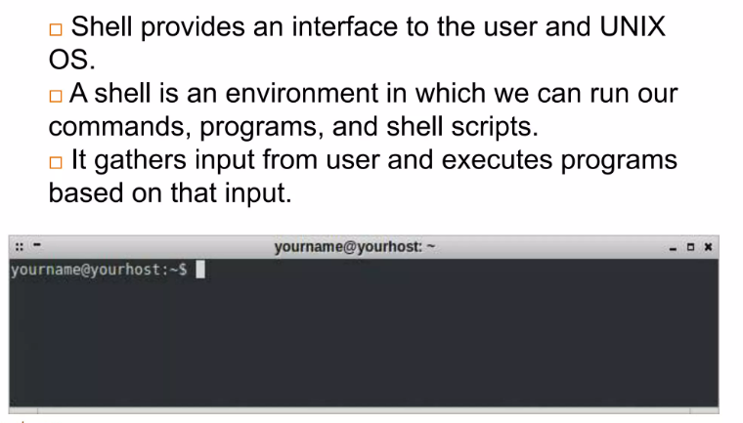

Slide 12
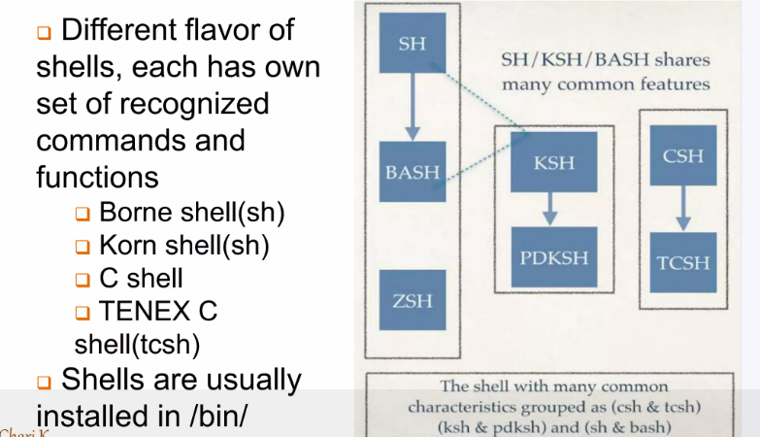

Slide 13
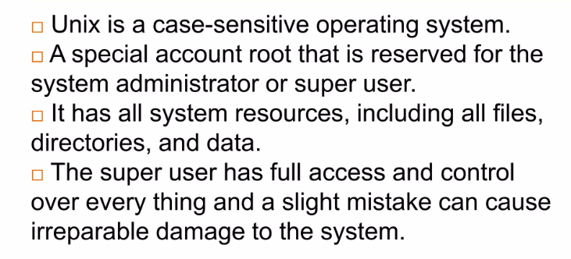

Slide 14
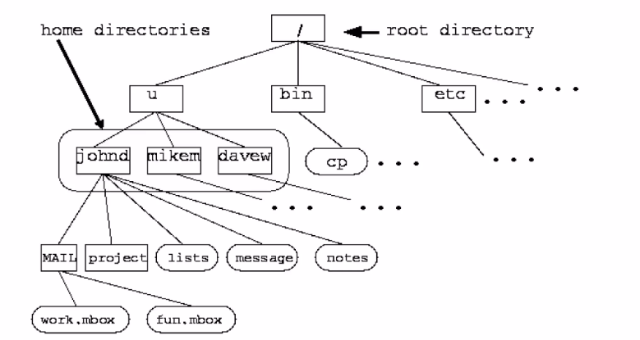
File Organization

Slide 15
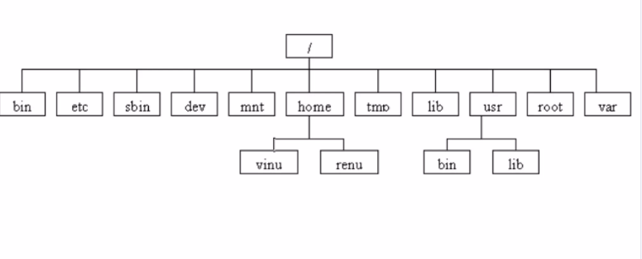

Slide 16
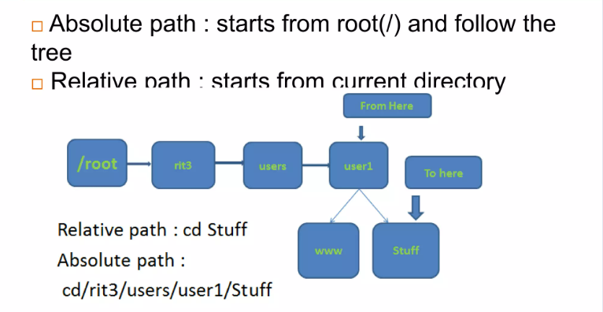
Absolute Path

Slide 17


Slide 18
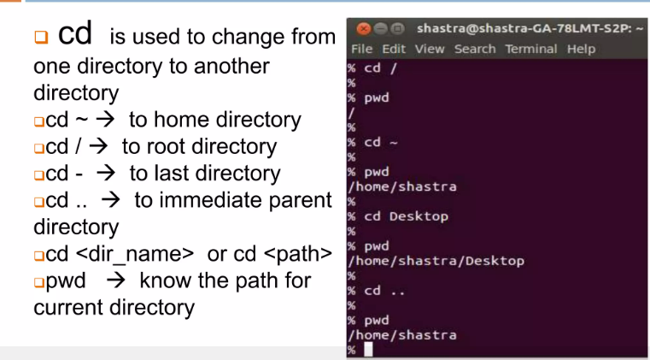
Changing Directory

Slide 19
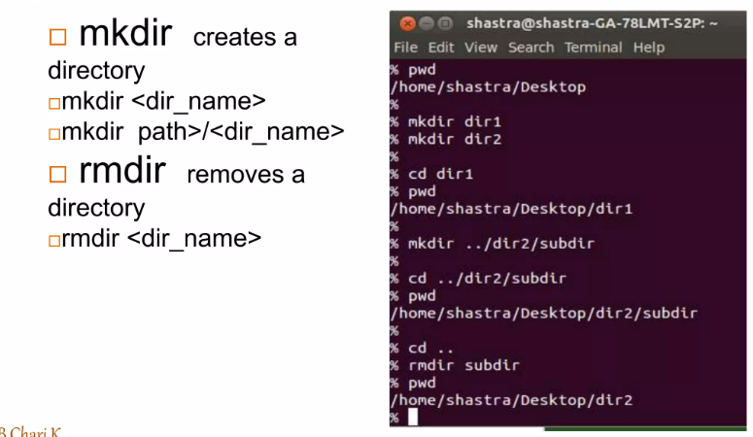
Creating and Removing Directories

Slide 20
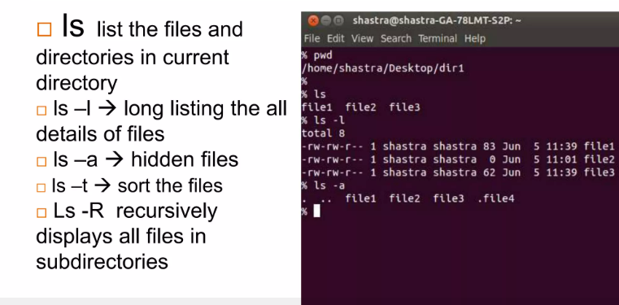
Listing Files

Slide 21
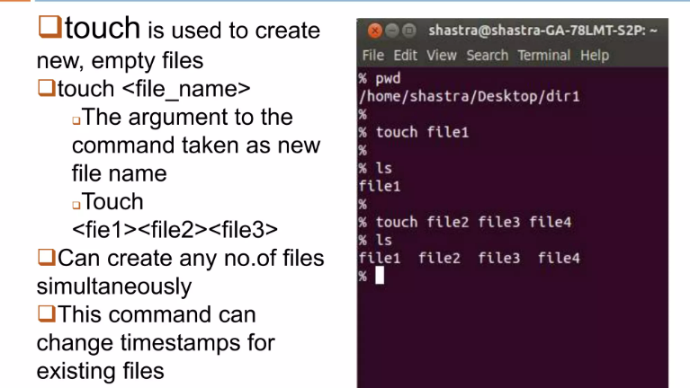
Creating Files

Slide 22
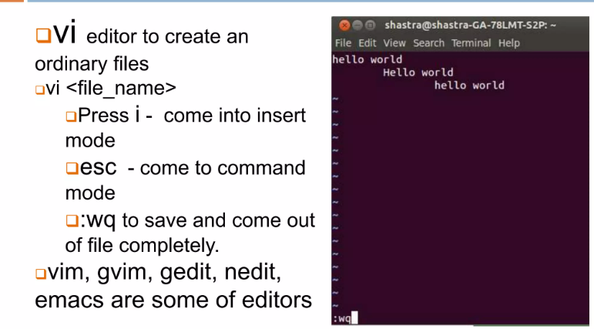
Creating and Editing files

Slide 23
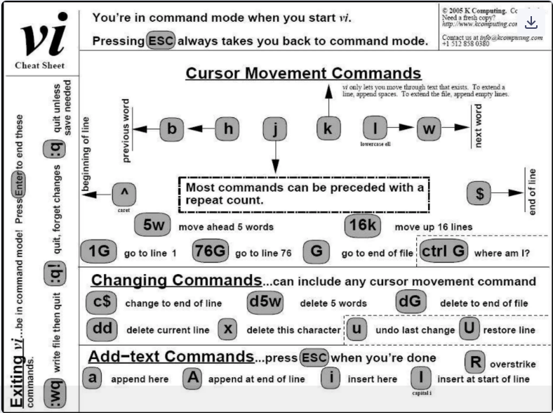

Slide 24
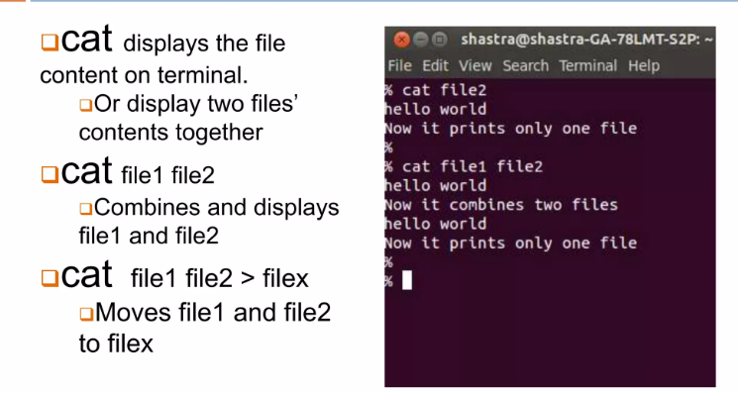
Display or concatenate files

Slide 25
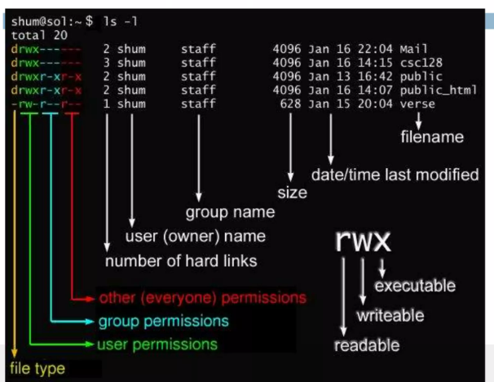
File Permission

Slide 26
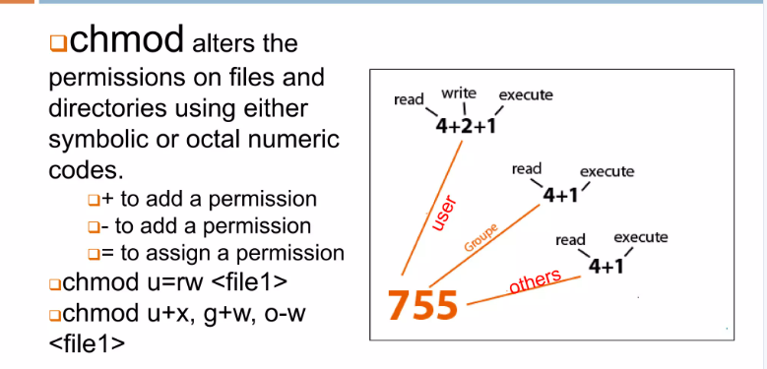
Change Permission

Slide 27
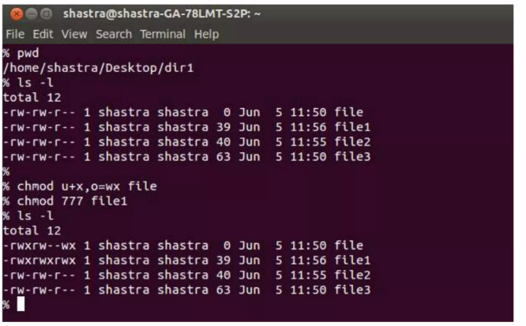
Change Permission

Slide 28
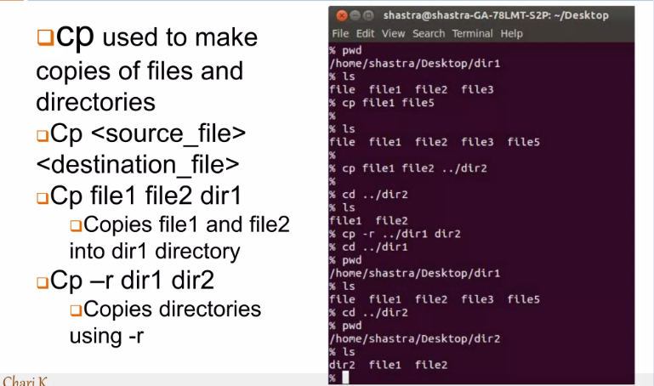
Copying and Moving Files

Slide 29
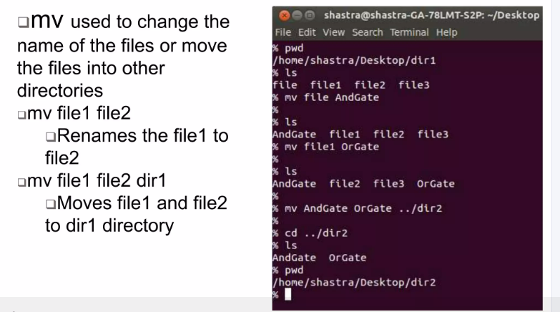
Moving and Renaming Files

Slide 30
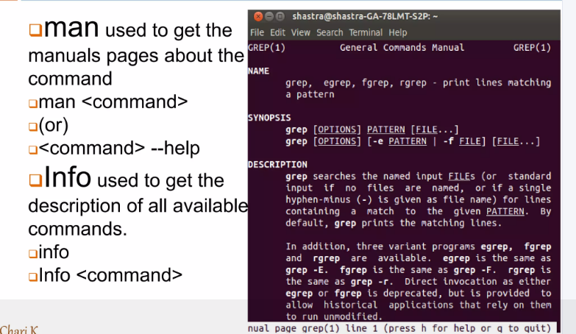
Getting Help

Slide 31
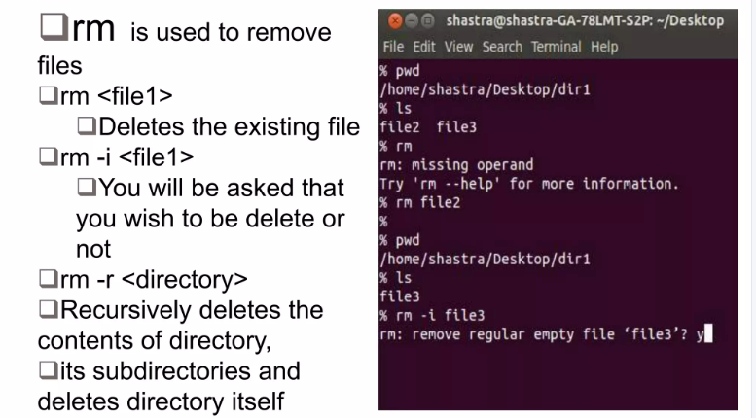
Removing Files

Slide 32
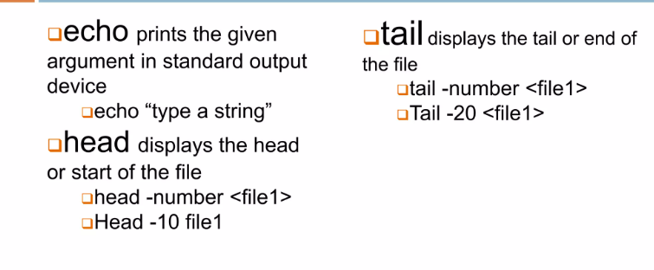
Display Commands

Slide 33
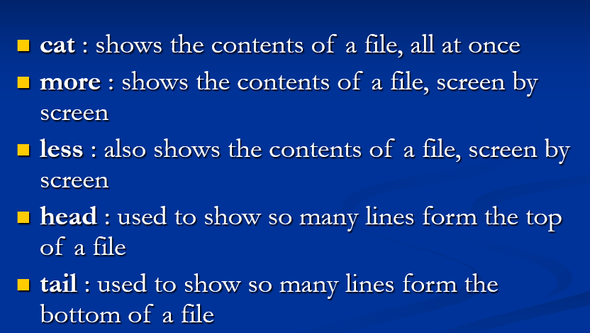
Commands

Slide 34
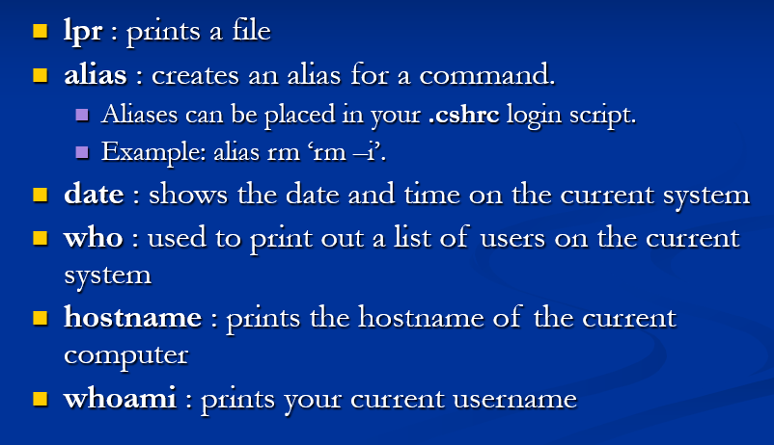
Commands

Slide 35
